Slide 1
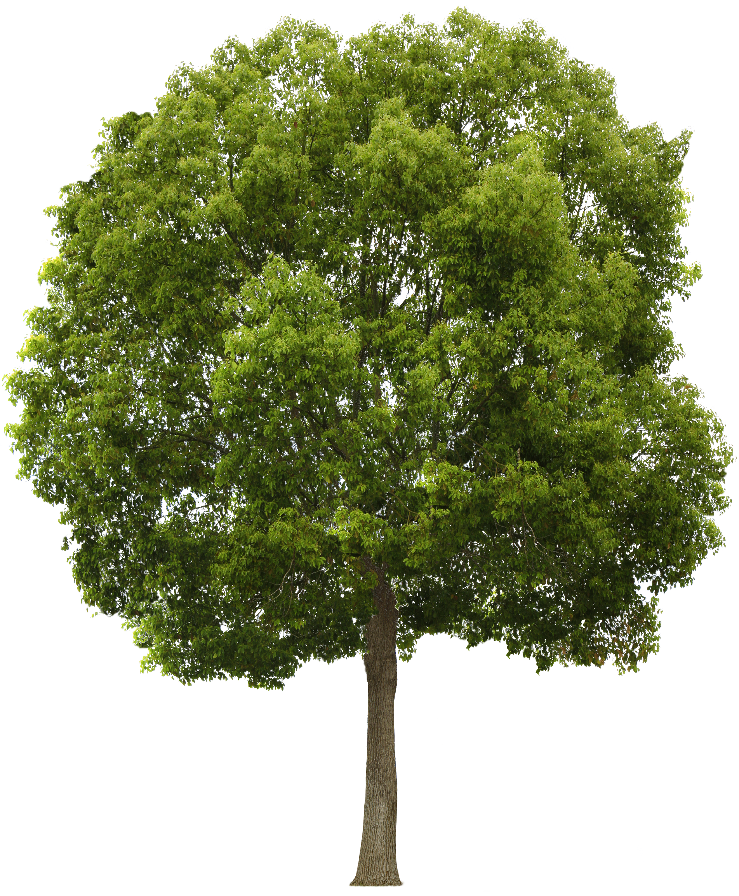
Tree Power
Powering IoT Sensor Networks with
Harvested Energy From Trees
James Stevens & Nick Purcell

Slide 2
Problem
Alternative Monitoring for use in the Environment
Find natural and renewable energy sources
Create a network of smart trees that can aggregate data from a large and remote region

Slide 3
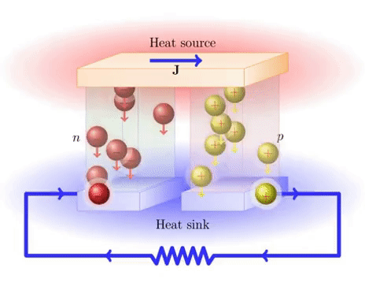
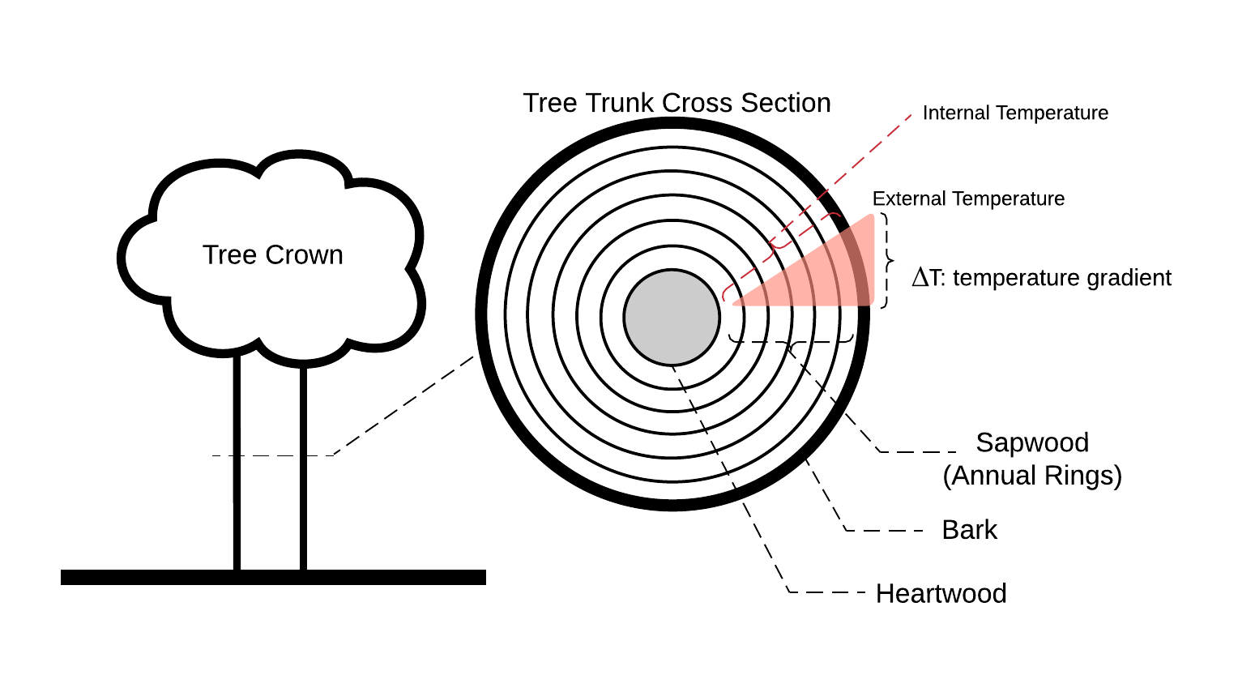
Solution / Theory
Trees attempt to maintain a 70° internal temperature
Seebeck Effect

Slide 4
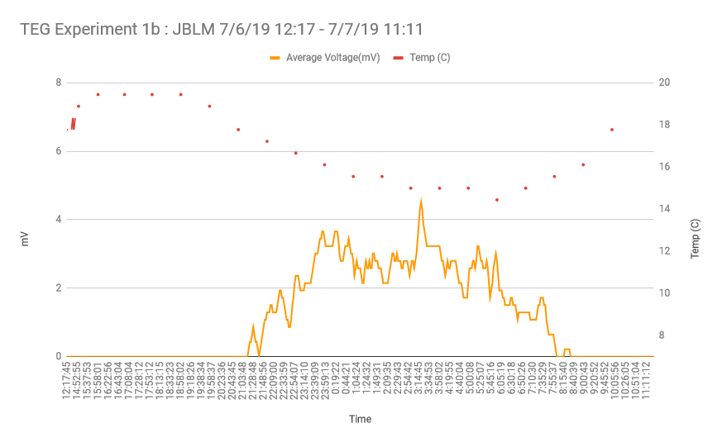
Experiment 1
Ran for ~9 Hours
18:00 – 03:00
~ 2 mV
~ 7 Hours

Slide 5
Experiment 2
Wednesday

Slide 6
Future Experiments

Slide 7
Making Trees Smart
The TEG charges a battery. A circuit detects when it is sufficiently charged and activates the environmental sensors and wireless transmitter.
Sensors include CO, CO2, O3, and dB
XBEE / LORA info

Slide 8
Conclusion

Slide 9
Sources

